Slide 1
SPACE STATE PROBLEM AND SEARCH TECHNIQUES
Dr. (Mrs.) Marion ADEBIYI

Slide 2
Problem space is a set of states and the set of operations or connections between to represent the problem.
The operators map from one state to another state.
One or more states that can be called initial states
One or more states which we need to reach, known as goal states
States in between initial states and goal states known as intermediate states.
So what is the solution? The solution to the given problem is nothing but a sequence of operators that map an initial state to a goal state.
This sequence forms a solution path.
What is the best solution? Obviously, the shortest path from the initial state to the goal state is the best one.

Slide 3
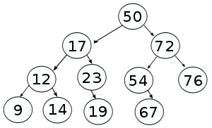
Shortest path has only a few operations compared to all other possible solution paths. Solution path forms a tree structure where each node is a state. So searching is nothing but exploring the tree from the root node. Where the initial state is the root node of the tree.

Slide 4
Search and Optimisation Problems
All these problems have got a common structure:
We are faced with an initial situation and we would like to achieve a certain goal.
At any point in time we have different simple actions available to us (e.g. “turn left” vs. “turn right”). Executing a particular sequence of such actions may or may not achieve the goal.
Search is the process of inspecting several such sequences and choosing one that achieves the goal.
For some applications, each sequence of actions may be associated with a certain cost.
A search problem where we aim not only at reaching our goal but also at doing so at minimal cost is an optimization problem.

Slide 5
Types of AI Search Techniques
In AI, solution can be found with less information or with more information. It all depends on the problem we need to solve. Usually when we have more information it will be easy to solve the problem.
There are two kinds of AI search techniques:
Uninformed search and
Informed search.

Slide 6
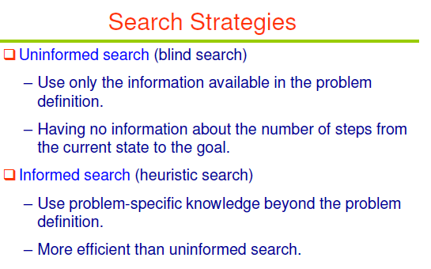

Slide 7
Uninformed Search or Blind Search
Sometimes we may not get much relevant information to solve a problem. Suppose we lost our car key and we are not able to recall where we left, we have to search for the key with some information such as in which places we used to place it. It may be our pant pocket or may be the table drawer. If it is not there then we have to search the whole house to get it. The best solution would be to search in the places from the table to the wardrobe. Here we need to search blindly with fewer clues. This type of search is called uninformed search or blind search. There are two popular AI search techniques in this category:
Breadth first search and
Depth first search.

Slide 8
Breadth First Search
BFS is an uninformed search method that aims to expand and examine all nodes of a graph or combination of sequences by systematically searching through every solution. In other words, it exhaustively searches the entire graph or sequence without considering the goal until it finds it. It does not use a heuristic algorithm.
From the standpoint of the algorithm, all child nodes obtained by expanding a node are added to a FIFO (i.e., First In, First Out) queue. In typical implementations, nodes that have not yet been examined for their neighbors are placed in some container (such as a queue or linked list) called “open” and then once examined are placed in the container “closed”.

Slide 9
Depth First Search
Formally, DFS is an uninformed search that progresses by expanding the first child node of the search tree that appears and thus going deeper and deeper until a goal node is found, or until it hits a node that has no children. Then the search backtracks, returning to the most recent node it has not finished exploring. In a non-recursive implementation, all freshly expanded nodes are added to a stack for exploration.

Slide 10
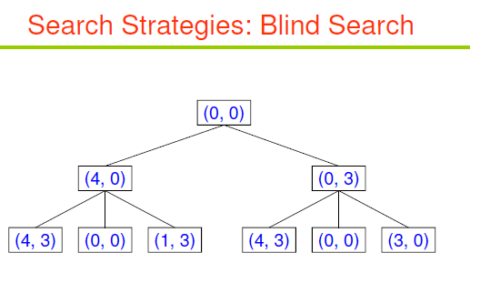
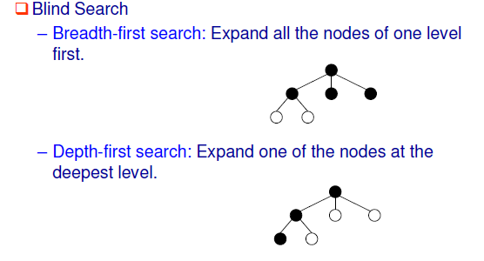

Slide 11
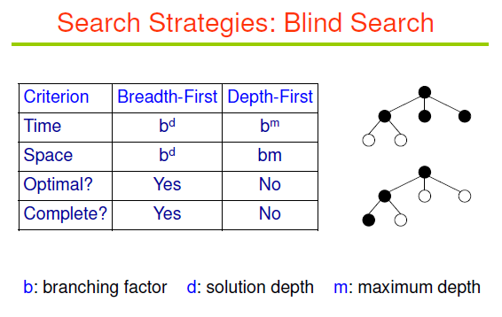

Slide 12
Breadth First Search Vs Depth First Search
Breadth First Search | Depth First Search
Advantages
Optimal solutions are always found Multiple solutions found early | May arrive at solutions without examining much of search space
Will not go down blind alley for solution | Needs little memory (only node in current path needs to be stored)
Disadvantages
If solution path is long, the whole tree must be searched up to that depth | May settle for non-optimal solution
All of the tree generated must be stored in memory | May explore single unfruitful path for a long time (forever if loop exists!)

Slide 13
Informed Search or Heuristic Search
We can solve problems in an efficient manner if we have relevant information, clues or hints. The clues that help solve the problem constitute heuristic information. So informed search is also call heuristic search. Instead of searching one path or many paths, just like that informed search uses the given heuristic information to decide whether to explore the current state further.
A good example of Informed search technique is
Best first search technique

Slide 14
Best-First Search (Greedy Search)
Best-first search is a search algorithm, which explores a graph by expanding the most promising node chosen according to a specified rule.
Judea Pearl described best-first search as estimating the promise of node n by a “heuristic evaluation function f(n) which, in general, may depend on the description of n, the description of the goal, the information gathered by the search up to that point, and most important, on any extra knowledge about the problem domain.”
Some authors have used “best-first search” to refer specifically to a search with a heuristic that attempts to predict how close the end of a path is to a solution, so that paths, which are judged closer to a solution, are extended first. This specific type of search is called greedy best-first search.

Slide 15
A good example of problem
Hill climbing is an AI search algorithm that explores the neighboring states, chooses the most promising state as successor, and continues searching for the subsequent states.
Once a state is explored, hill climbing algorithm simply discards it. Hill climbing search technique can make substantial savings if it has reliable information. It has to face three challenges: foothill, ridge and plateau.
Best first search is a heuristic search technique that stores the explored states as well so that it can backtrack if it realizes that the present path proves unworthy

Slide 16
Class Exercise: Constraint Satisfaction Problems
The Eight Queens problem
The task is to place eight queens on an 8*8 chessboard such that no two queens are on the same row, column or diagonal.

